Slide 1



SWAN
FFC Open
Model Name: BFX-UA300
Document Version: ALT_STB_MP_CSMTINS_001
Issued Date: 2022.02.08

Slide 2
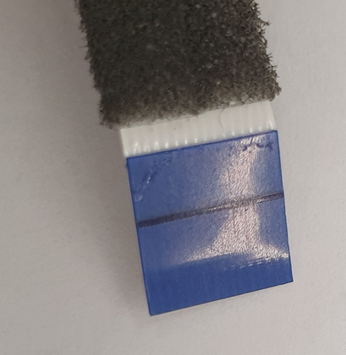
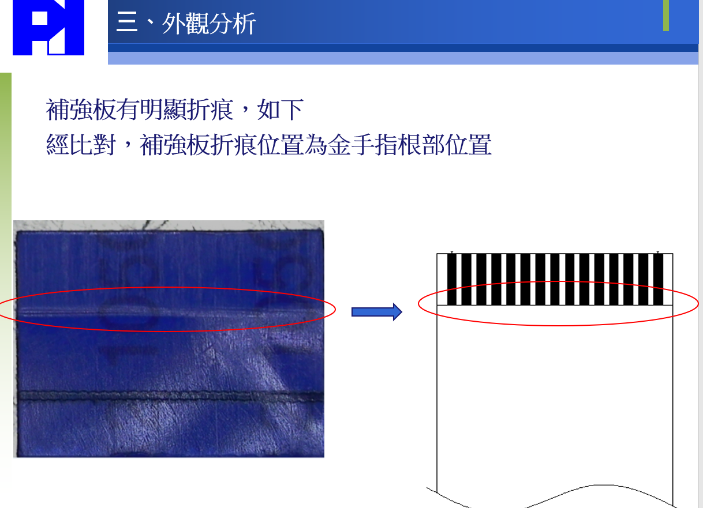
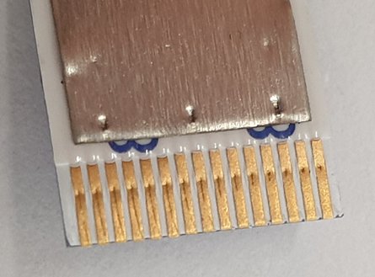
Vender report of root cause
The root cause by the factory was wrong.
Factory defined the folding line
DEFECTED FFC from field defect unit
Action item
FII and Factory should be find again
the root cause.
find the FFC improvements

Slide 3
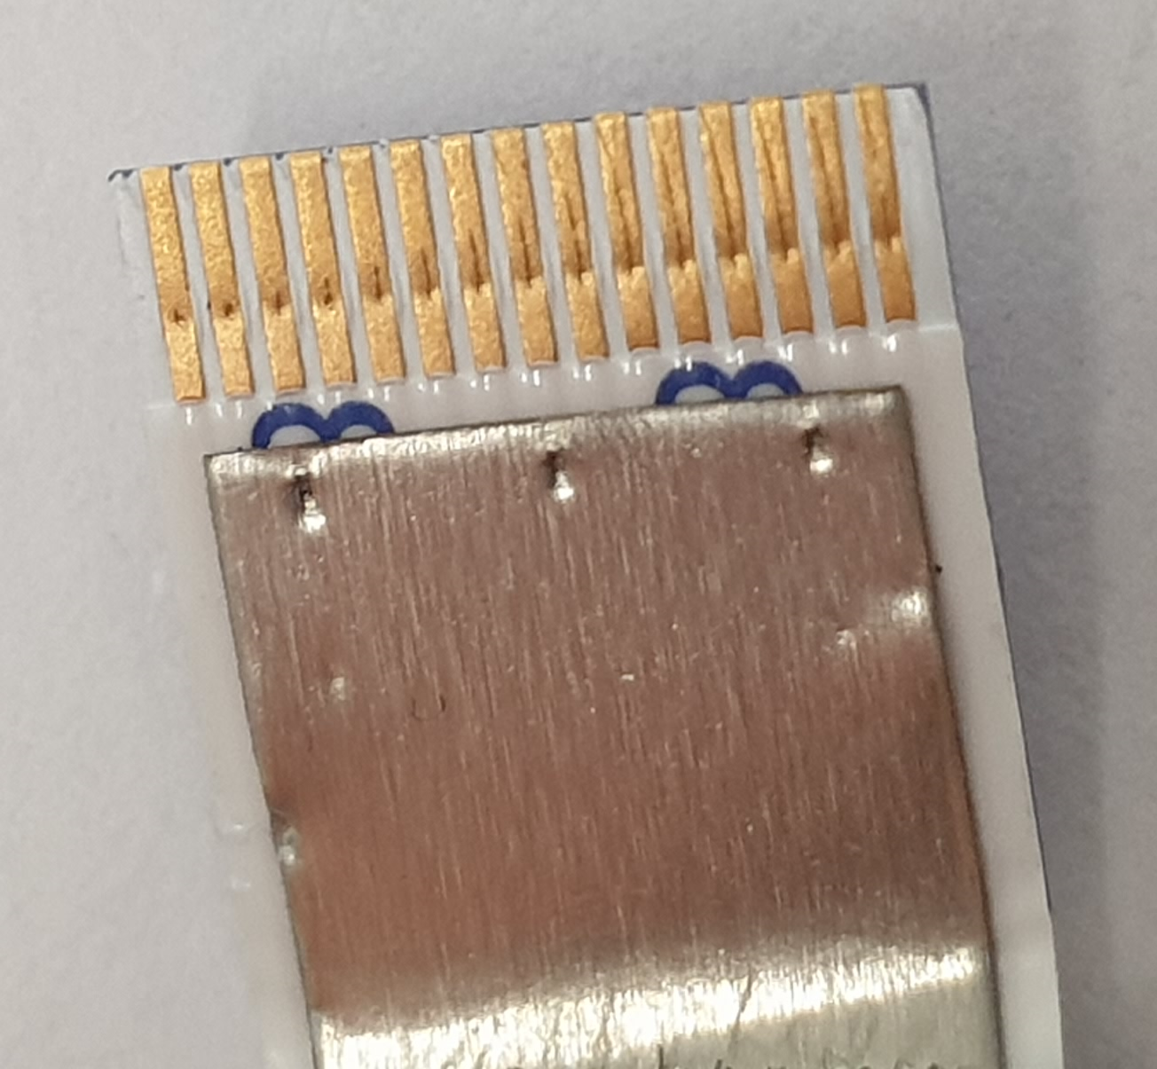

Slide 4

Thank you.

